Slide 1

Image-Related
Neural Networks
How to see like a human
Yordan Darakchiev
Technical Trainer
iordan93@gmail.com

Slide 2
sli.do
#DeepLearning

Slide 3
Table of Contents
Convolutional neural networks
  Operations
  Architectures
Generalizations
  ResNet
  1x1 convolutions, "network-in-network"
  Object localization

Slide 4
Convolutional
Neural Networks
Learning from images

Slide 5
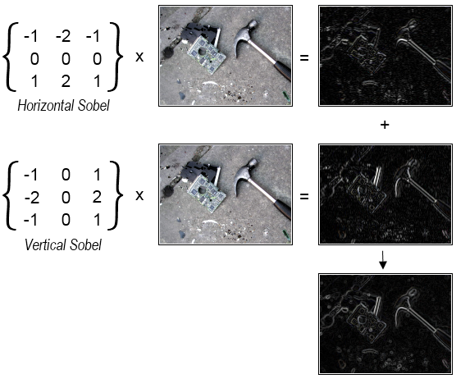
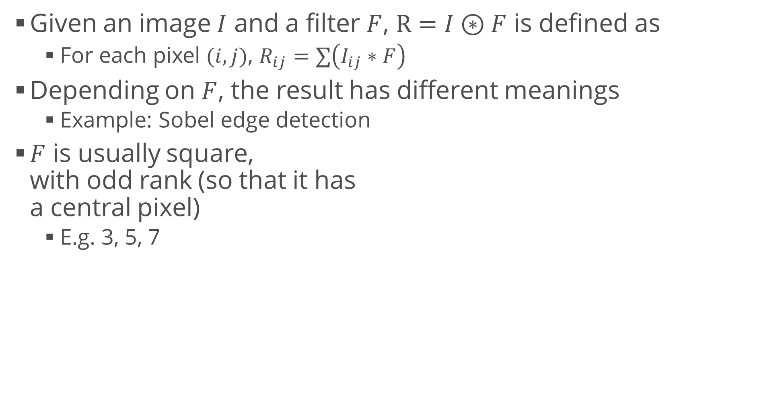
Convolution
Given an image $I$ and a filter $F$, $R=I⊛F$ is defined as
  For each pixel $(i,j)$, $R_{ij}=∑\left(I_{ij}∗F\right)$
Depending on $F$, the result has different meanings
  Example: Sobel edge detection
$F$ is usually square,
with odd rank (so that it has
a central pixel)
  E.g. 3, 5, 7

Slide 6
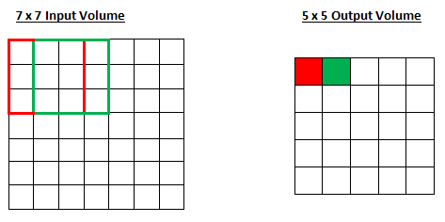
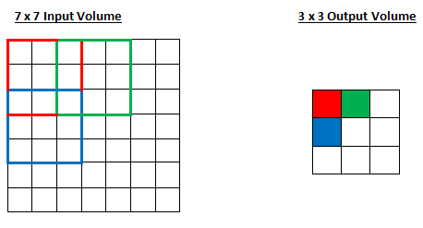
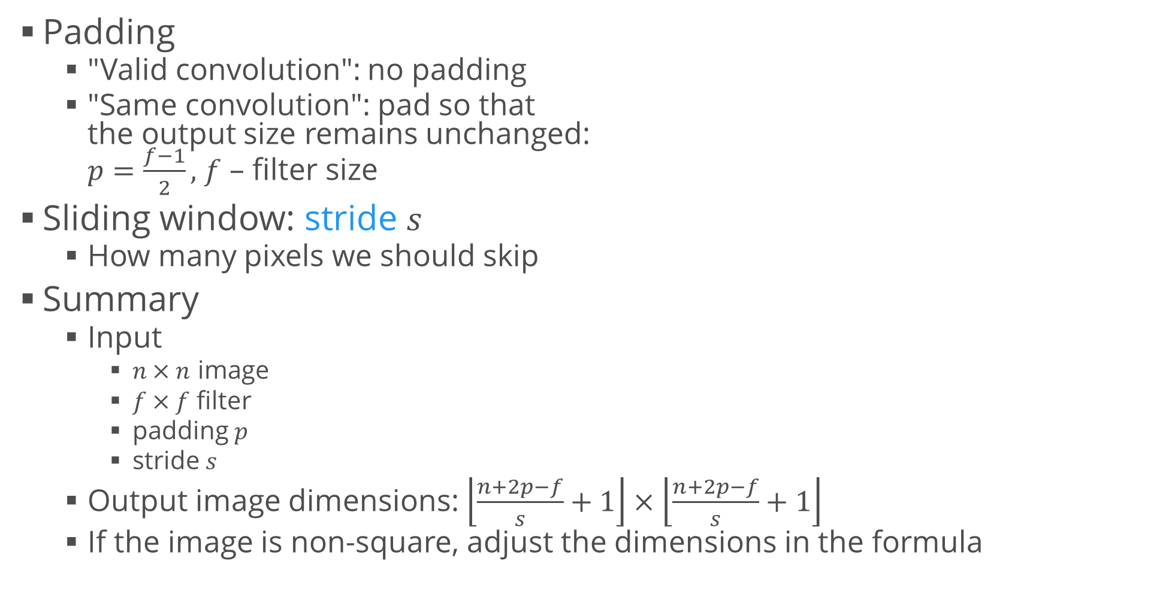
Convolution (2)
Padding
  "Valid convolution": no padding
  "Same convolution": pad so that
  the output size remains unchanged:
  $p=\frac{f−1}{2},$ $f$ – filter size
Sliding window: stride $s$
  How many pixels we should skip
Summary
  Input
    $n×n$ image
    $f×f$ filter
    padding $p$
    stride $s$
  Output image dimensions: $\left\lfloor \frac{n+2p−f}{s}+1\right\rfloor ×\left\lfloor \frac{n+2p−f}{s}+1\right\rfloor$
  If the image is non-square, adjust the dimensions in the formula

Slide 7
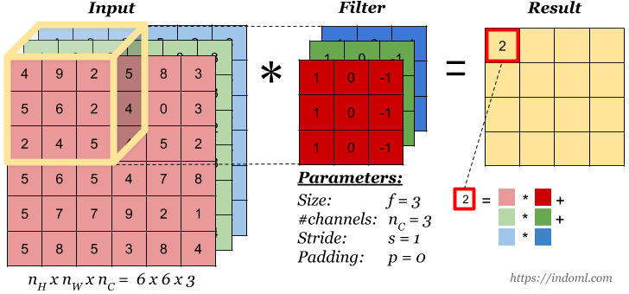
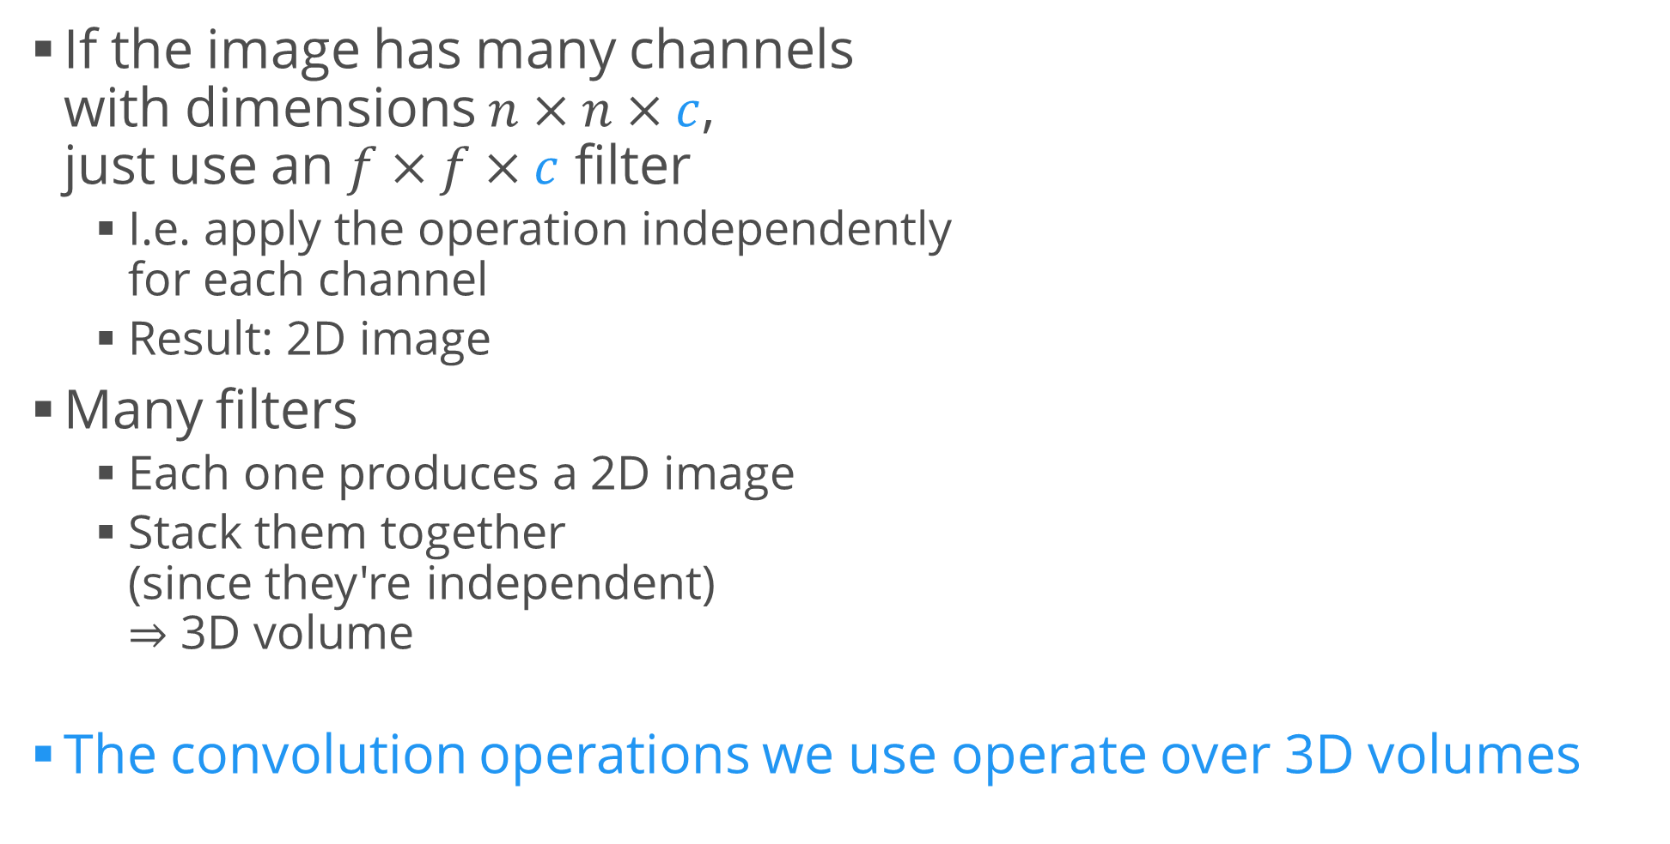
Convolution over Volume
If the image has many channels
with dimensions $n×n×c$,
just use an $f×f×c$ filter
  I.e. apply the operation independently
  for each channel
  Result: 2D image
Many filters
  Each one produces a 2D image
  Stack them together
  (since they're independent)
  $⇒$ 3D volume
The convolution operations we use operate over 3D volumes

Slide 8
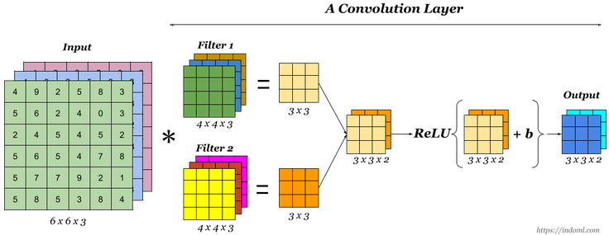
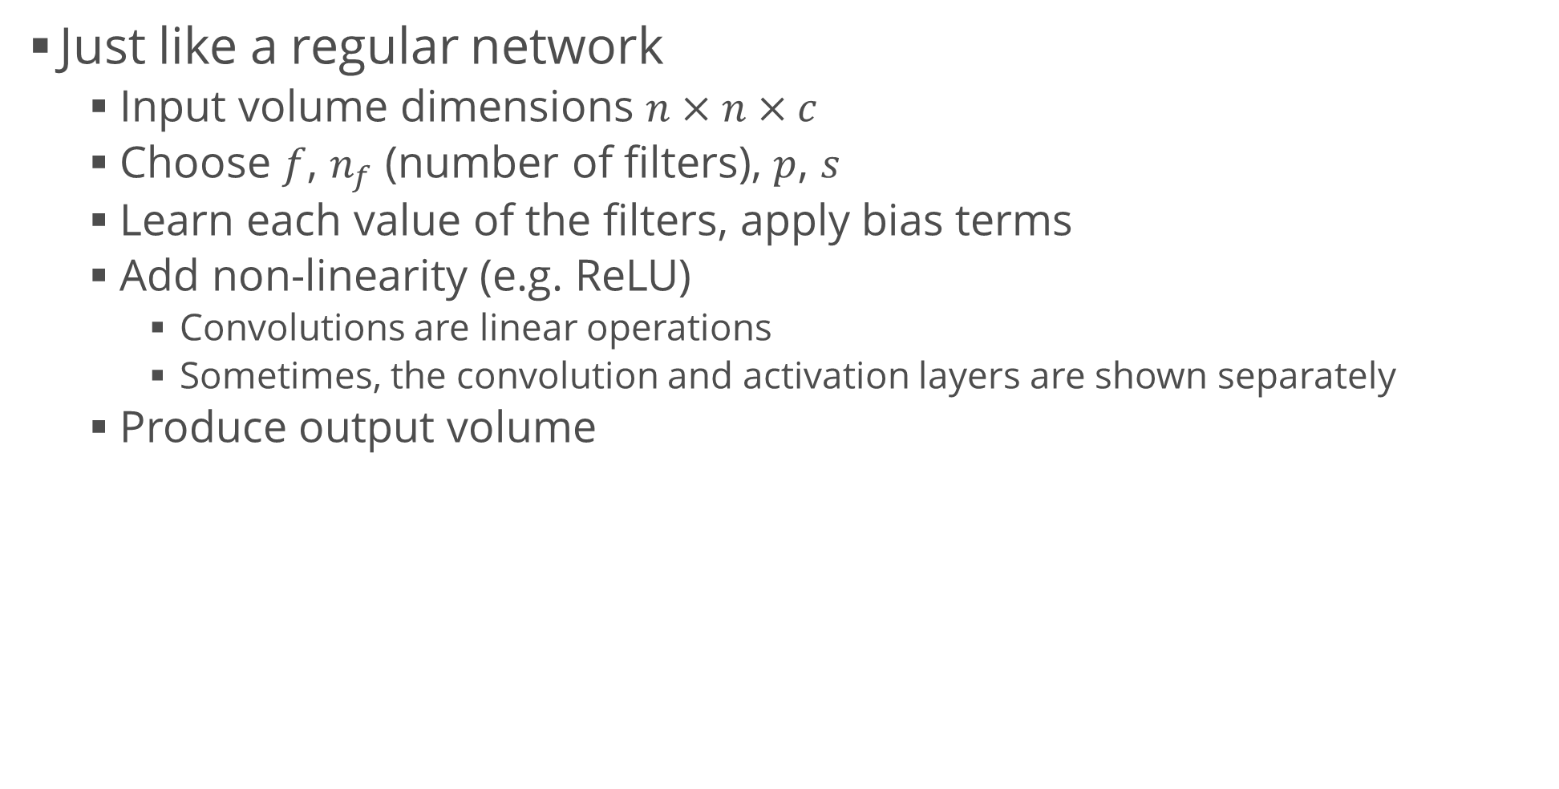
Convolutional Layers
Just like a regular network
  Input volume dimensions $n×n×c$
  Choose $f$, $n_{f}$ (number of filters), $p$, $s$
  Learn each value of the filters, apply bias terms
  Add non-linearity (e.g. ReLU)
    Convolutions are linear operations
    Sometimes, the convolution and activation layers are shown separately
  Produce output volume

Slide 9
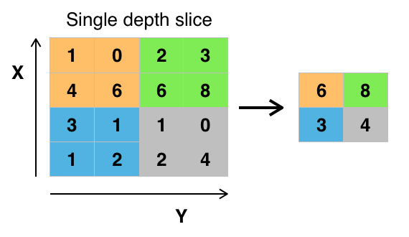
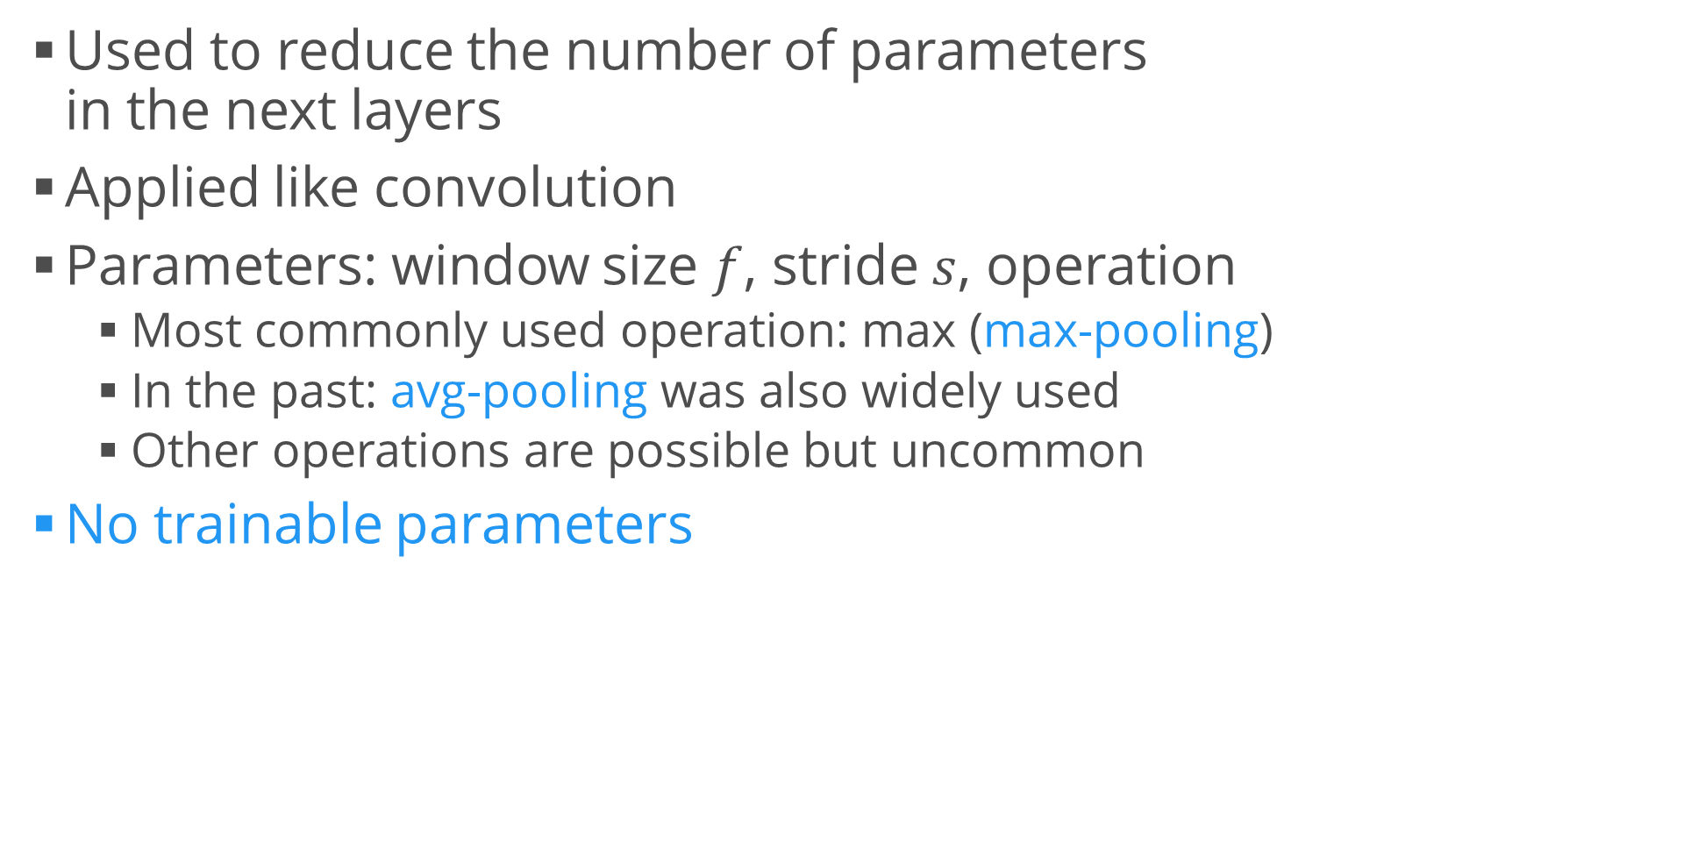
Pooling
Used to reduce the number of parameters
in the next layers
Applied like convolution
Parameters: window size $f$, stride $s$, operation
  Most commonly used operation: max (max-pooling)
  In the past: avg-pooling was also widely used
  Other operations are possible but uncommon
No trainable parameters

Slide 10
Why Do Convolutions Work?
Image assumptions
  Individual features are relatively localized
  The relative (not absolute) position of features is really important
Convolutions help us to share computations
  An edge detector is useful in many parts of the image
Each filter has a low-dimensional input
  Simplifies computations
Visualizing and Understanding Convolutional Networks,
Matthew Zeiler, 2014

Slide 11
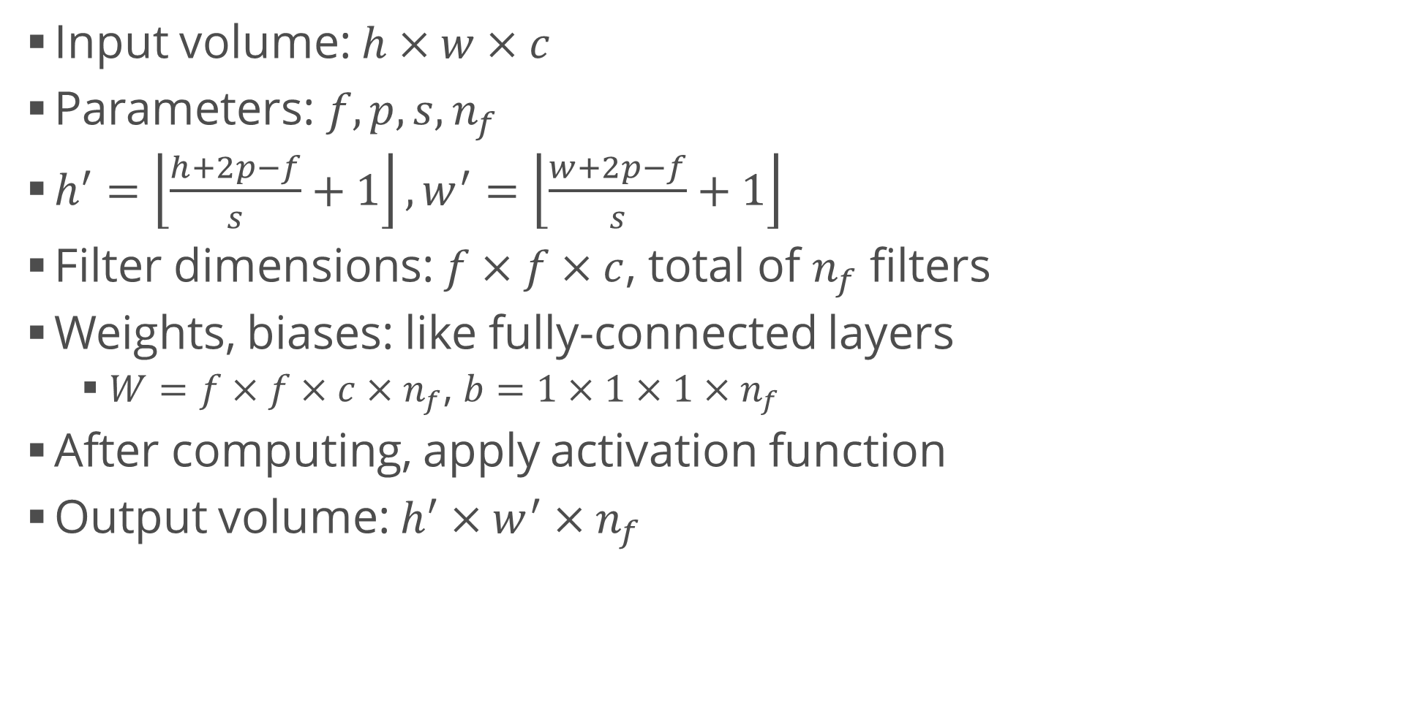
Convolutional Layer Architecture
Input volume: $h×w×c$
Parameters: $f,p,s,n_{f}$
$h^{′}=\left\lfloor \frac{h+2p−f}{s}+1\right\rfloor ,w^{′}=\left\lfloor \frac{w+2p−f}{s}+1\right\rfloor$
Filter dimensions: $f×f×c$, total of $n_{f}$ filters
Weights, biases: like fully-connected layers
  $W=f×f×c×n_{f}$, $b=1×1×1×n_{f}$
After computing, apply activation function
Output volume: $h^{′}×w^{′}×n_{f}$

Slide 12
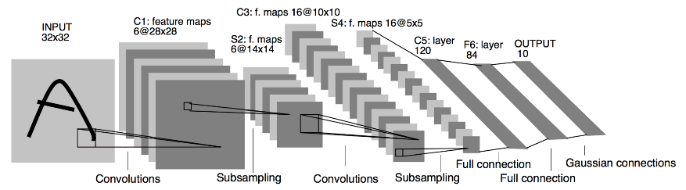
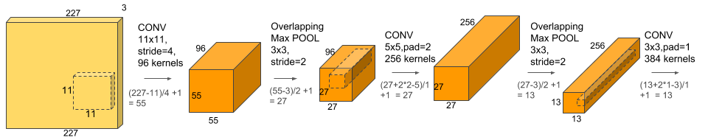
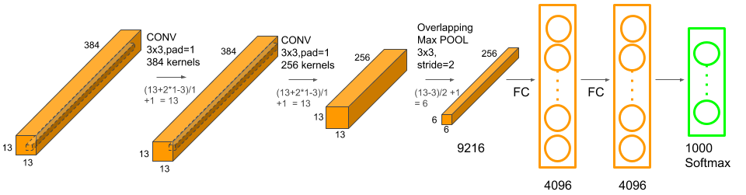
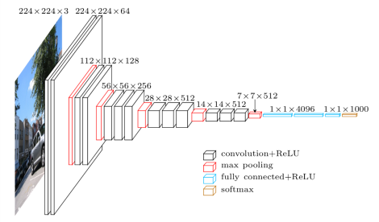
Convolutional Neural Networks
LeNet-5 (Yann LeCun, 1998)
AlexNet (Alex Krizhevsky, 2012)
VGG-19 (Karen Simonyan, 2014)

Slide 13
Generalizations and Expansions
Applying other tricks

Slide 14
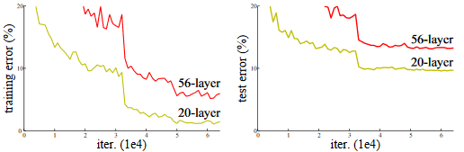
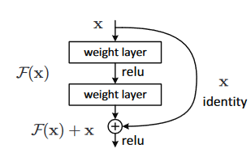
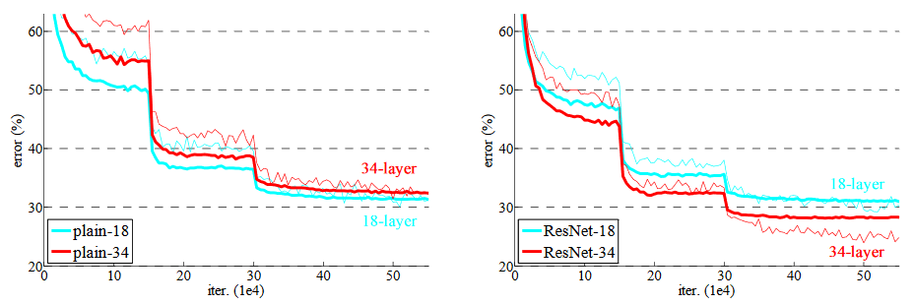
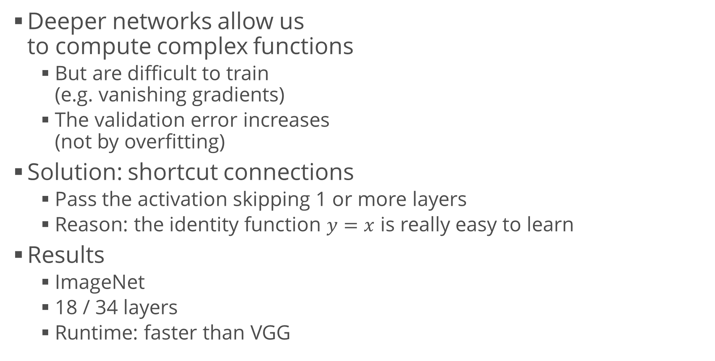
Residual Networks (ResNets)
Deeper networks allow us
to compute complex functions
  But are difficult to train
  (e.g. vanishing gradients)
  The validation error increases
  (not by overfitting)
Solution: shortcut connections
  Pass the activation skipping 1 or more layers
  Reason: the identity function $y=x$ is really easy to learn
Results
  ImageNet
  18 / 34 layers
  Runtime: faster than VGG

Slide 15
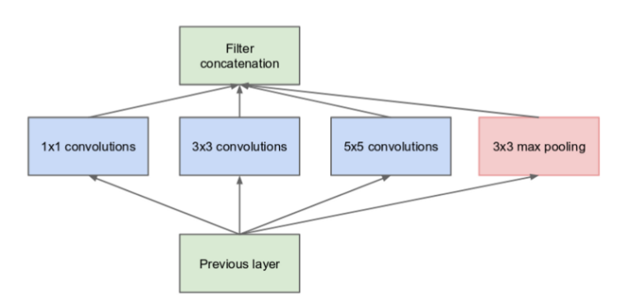
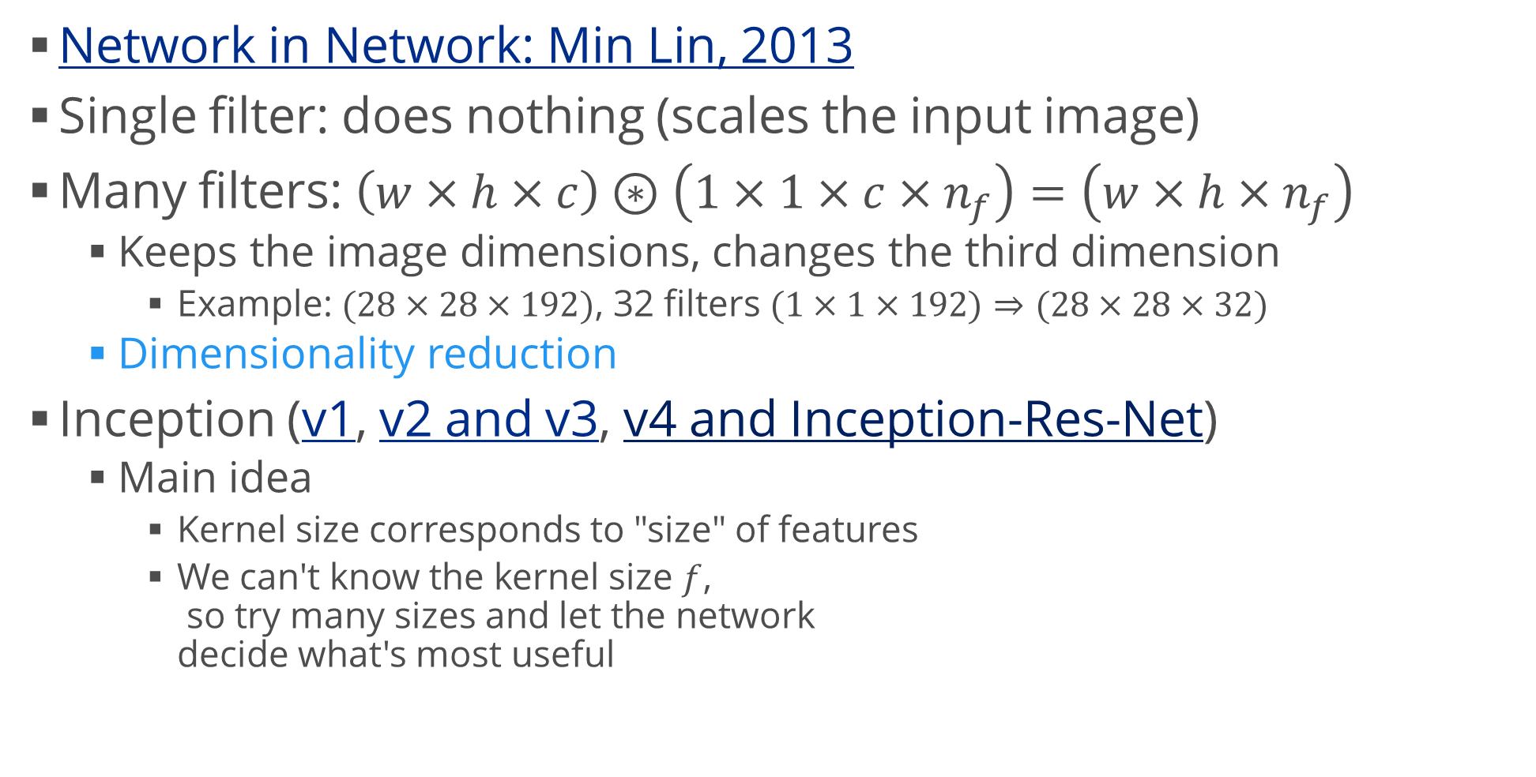
1x1 Convolutions
Network in Network: Min Lin, 2013
Single filter: does nothing (scales the input image)
Many filters: $\left(w×h×c\right)⊛\left(1×1×c×n_{f}\right)=\left(w×h×n_{f}\right)$
  Keeps the image dimensions, changes the third dimension
    Example: $(28×28×192)$, 32 filters $(1×1×192)$ $⇒(28×28×32)$
  Dimensionality reduction
Inception (v1, v2 and v3, v4 and Inception-Res-Net)
  Main idea
    Kernel size corresponds to "size" of features
    We can't know the kernel size $f$,
    so try many sizes and let the network
    decide what's most useful

Slide 16
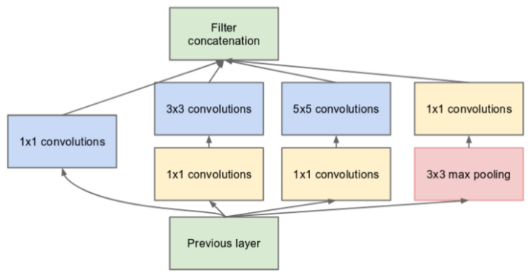
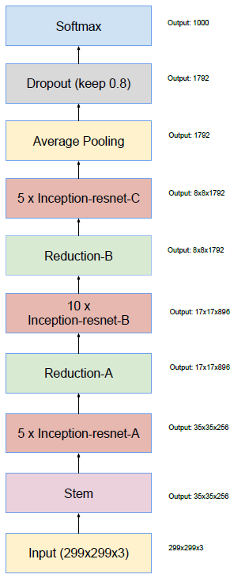
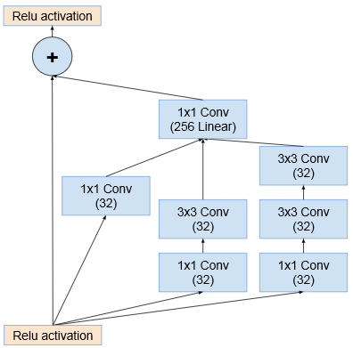
Inception
Problem: lots of computations
  Solution: dimensionality reduction
  before each convolution
  "Inception block"
GoogLeNet: 9 inception modules
Inception-Res-Net
  A simple combination
  of the two concepts
  Idea: create a deeper
  inception block,
  simplifying learning
  through a ResNet connection

Slide 17
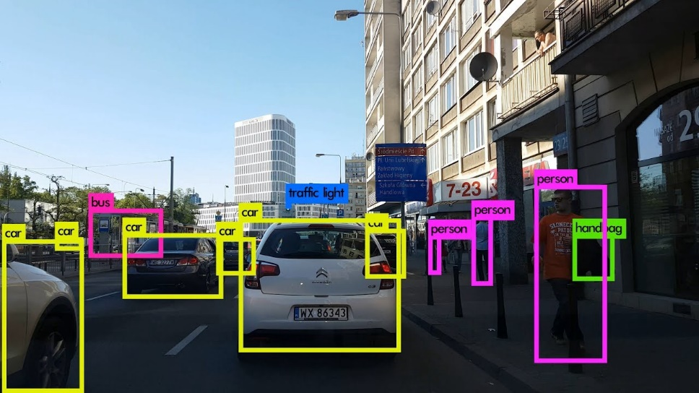
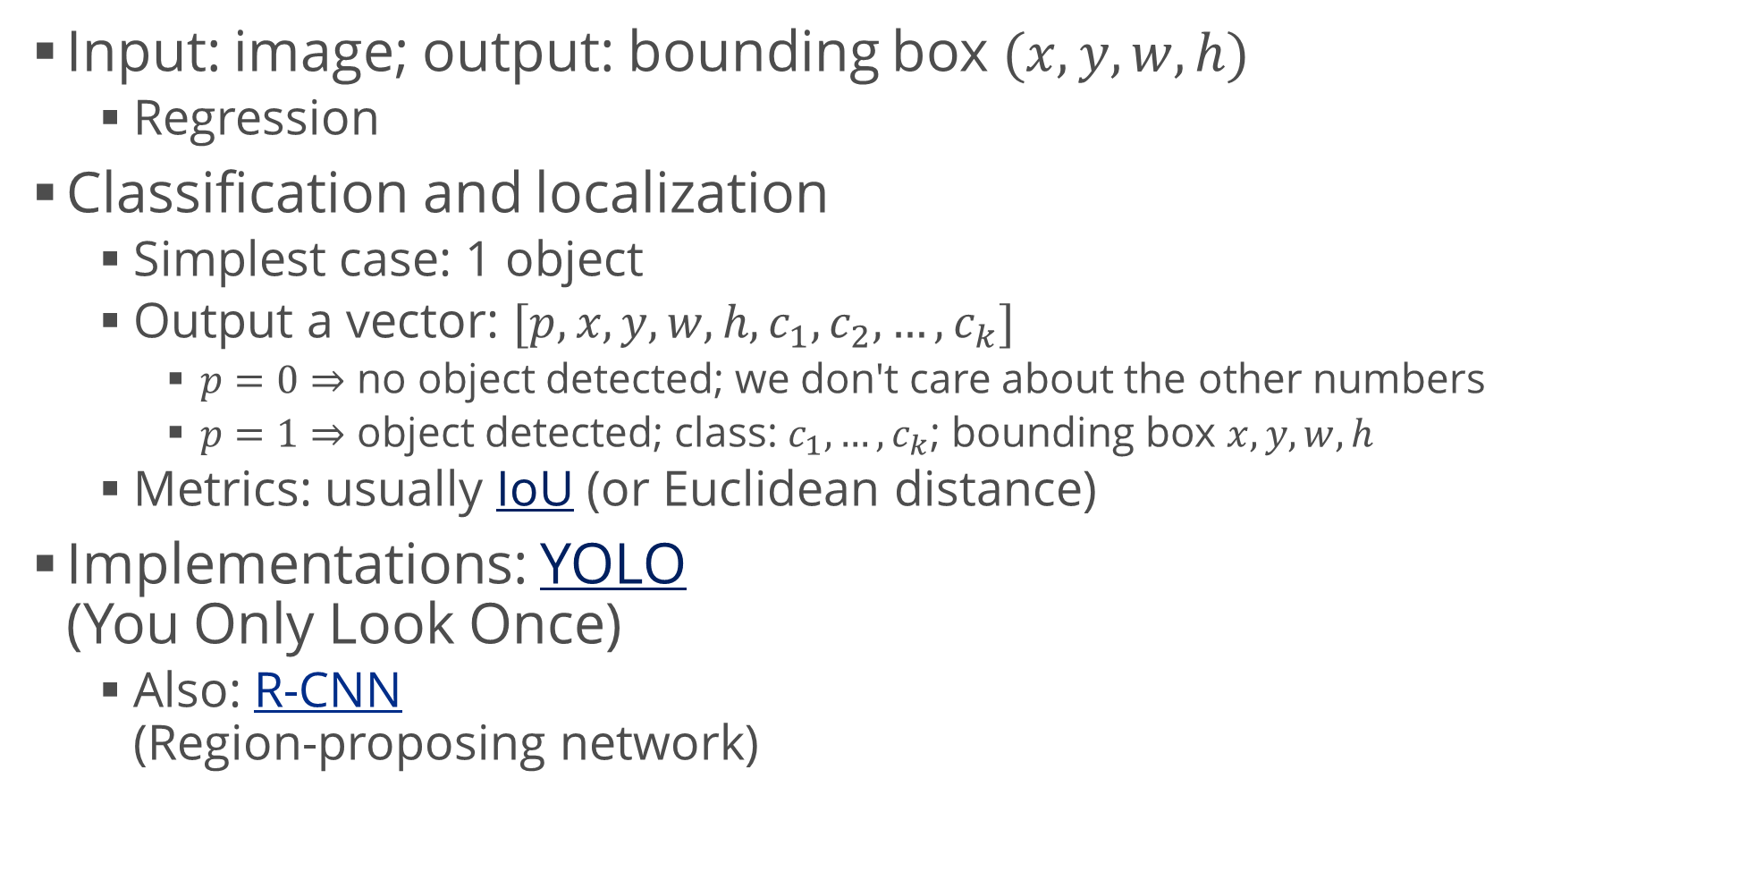
Object Localization
Input: image; output: bounding box $(x,y,w,h)$
  Regression
Classification and localization
  Simplest case: 1 object
  Output a vector: $[p, x, y, w, h, c_{1},c_{2},…,c_{k}]$
    $p=0⇒$ no object detected; we don't care about the other numbers
    $p=1⇒$ object detected; class: $c_{1},…,c_{k}$; bounding box $x,y,w,h$
  Metrics: usually IoU (or Euclidean distance)
Implementations: YOLO
(You Only Look Once)
  Also: R-CNN
  (Region-proposing network)

Slide 18
Summary
Convolutional neural networks
  Operations
  Architectures
Generalizations
  ResNet
  1x1 convolutions, "network-in-network"
  Object localization

